Slide 1


Slide 2
O - Obstacle Avoiding B - Bluetooth Control H - Human Following
Robot
Presented By:
Adison Giri Hawana Tamang
Kushal Pathak

Slide 3
Table of Contents
Introduction
Objectives
Features
Hardware Specification
Problems & Solution
Applications
Future Prospects
Conclusion

Slide 4
Introduction
An Arduino Bluetooth control uses Arduino microcontroller as its main control system for controlling a device, such as a robot, using a Bluetooth connection to send commands wirelessly.
Human following is a type of behaviour in which a robot follows a person as they move.
Such a robot could have a variety of practical applications, such as assisting people with mobility issues, serving as a personal assistant, or being used in entertainment or education.

Slide 5

Objectives of Bluetooth Control Arduino Robot

Slide 6
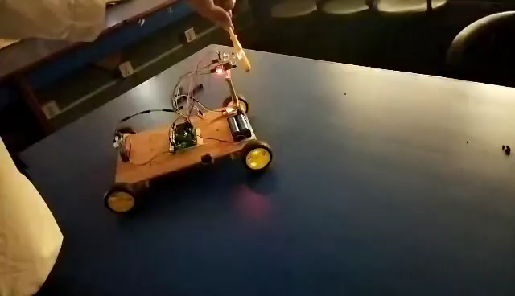
To provide a wireless method
1
To enable remote control of the robot
2
To allow for greater flexibility in controlling
3
To make the robot more accessible to users
4

Slide 7
Features of Bluetooth Control
Wireless Control
SmartPhone Compatibility
Lower Power Simulation
Flexibility

Slide 8
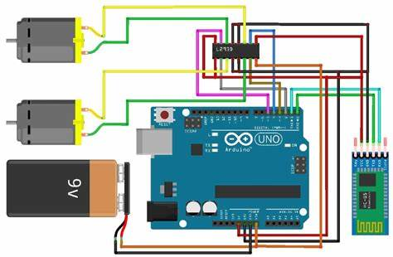

Slide 9

Objectives of Human Following
Robot

Slide 10
To create a robot that can autonomously follow.
To advance the field of robotics and create new possibilities for human-robot interaction.
To develop a system that uses sensors and programming
To provide a practical application for a robot with human following capabilities
1
2
3
4

Slide 11
1
Autonomous Tracking
2
Real Time Tracking
3
Obstacle Detection
4
Navigation Capabilities
5
Versatility
Features of Human Following Robot

Slide 12
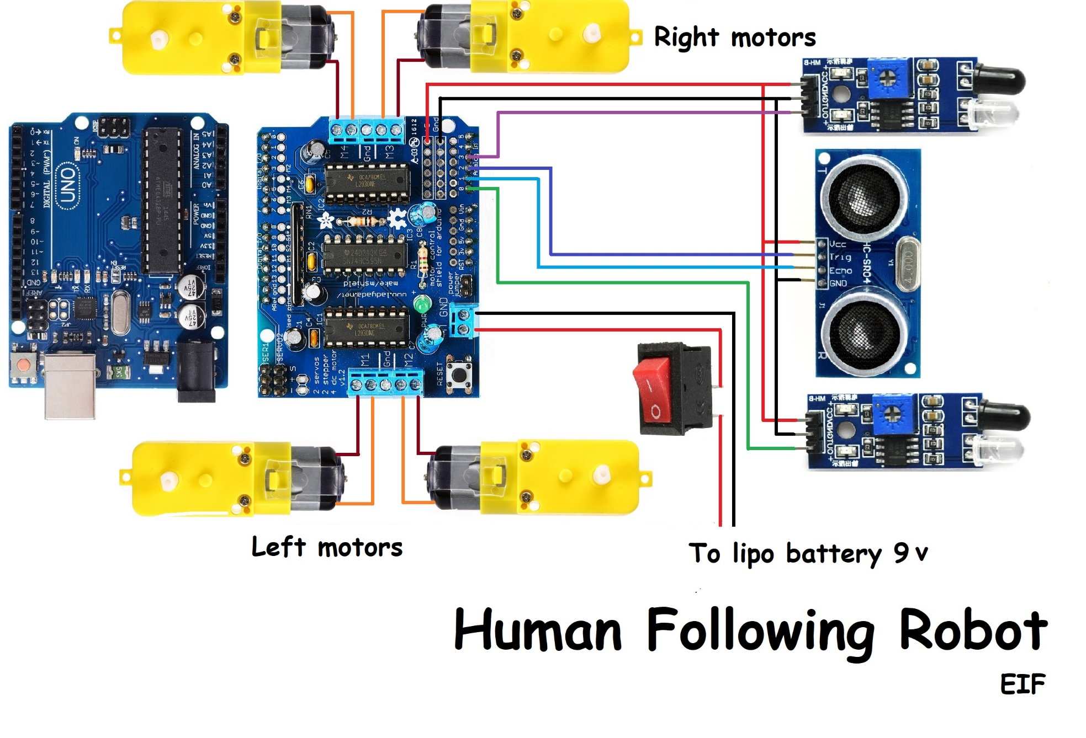

Slide 13
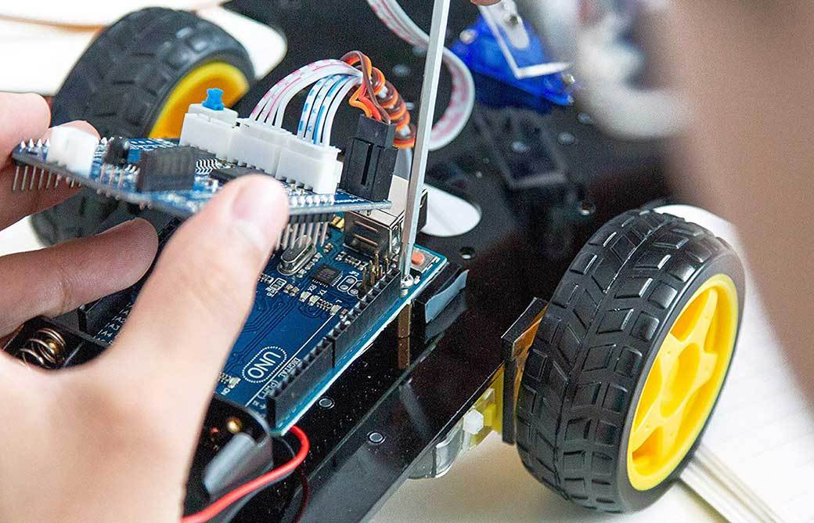
Hardware Specification
Arduino UNO Board
Motor/Wheel Motor
Motor Driver Shield
Switch
Battery Holder
Ultrasonic Sensor
IR Sensor
Bluetooth Module
Servo Motor

Slide 14
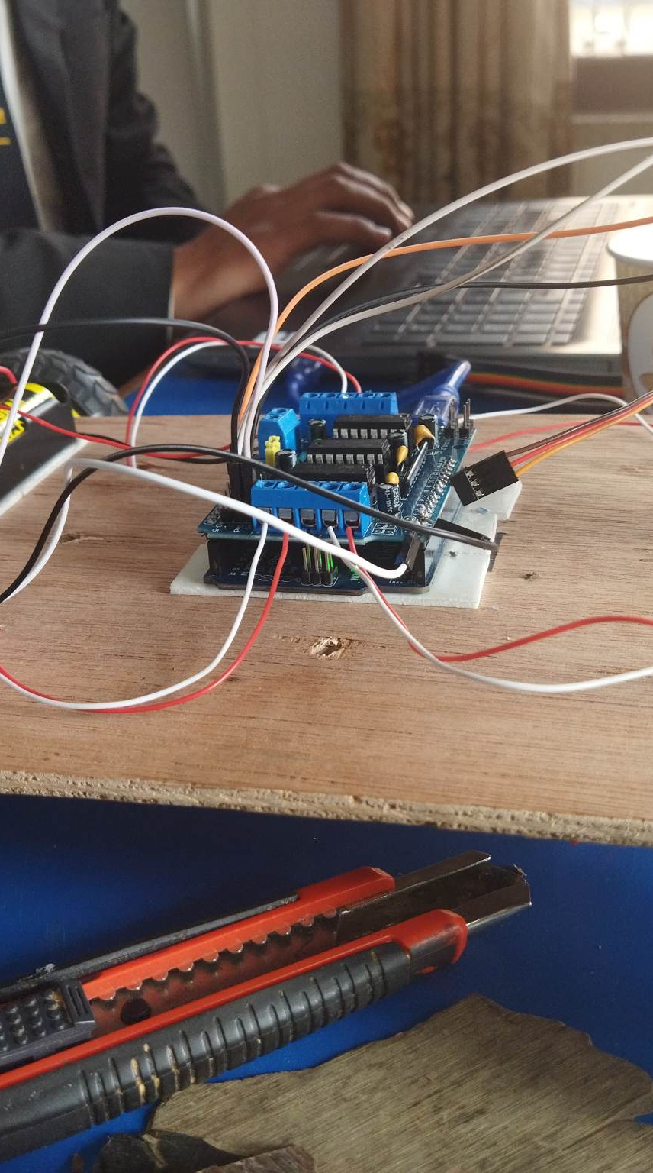
Problem & Solutions
Limited Range of Control
Potential for wire tangling
Inconvenient control
Limited Mobility
Lack of autonomy
Inability to assist people with mobility issues
Limited Interaction

Slide 15
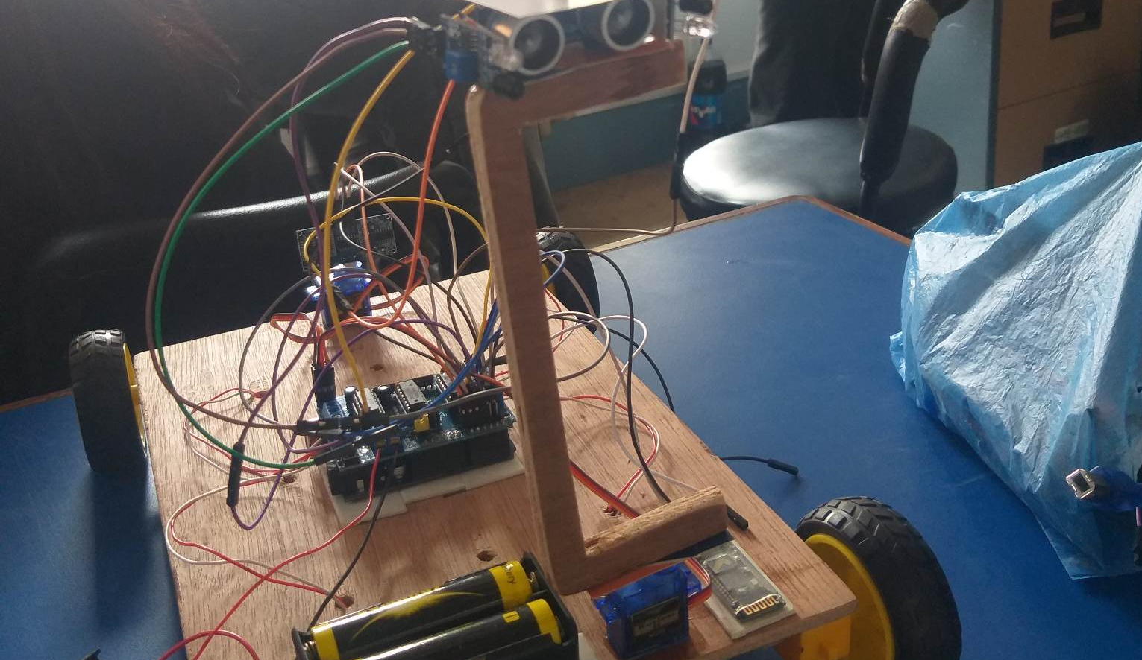
Solutions

Slide 16
Solutions
To overcome the limited range of control and wire tangling, Bluetooth control can be implemented, allowing for wireless control of the robot.
To make control more convenient, a smartphone app can be developed to control the robot, eliminating the need for physical wires or cables.
To overcome the limitations of mobility and lack of autonomy, human following capabilities can be implemented, allowing the robot to move autonomously and follow a person's movements.
To provide assistance to people with mobility issues, a human following robot can be designed specifically to provide assistance in tasks such as carrying objects or opening doors.
To increase interaction, a human following robot can be designed with additional features such as speech recognition and natural language processing, allowing for more natural and intuitive communication with people.

Slide 17
Application of Bluetooth
Home Automation
Robotics
Education

Slide 18
Application of Human
Health Care
Personal Assistant
Entertainment
Industrial Automation

Slide 19
Future Prospects
Integration with other technologies
Enhanced Security
Increased Automation
Improvised Navigation
Enhanced sensor capabilities
Integration with other technologies

Slide 20
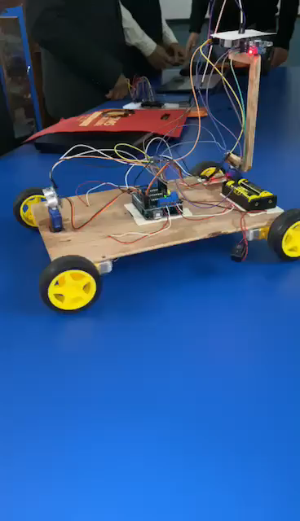
Conclusion
In conclusion, Bluetooth Control Arduino Robot and Human Following Arduino Robot are two technologies that have significant potential for enhancing the functionality and versatility of robotic systems.

